Slide 1
Book1
File created on: 3/3/21 9:15:18 PM EST

Slide 2
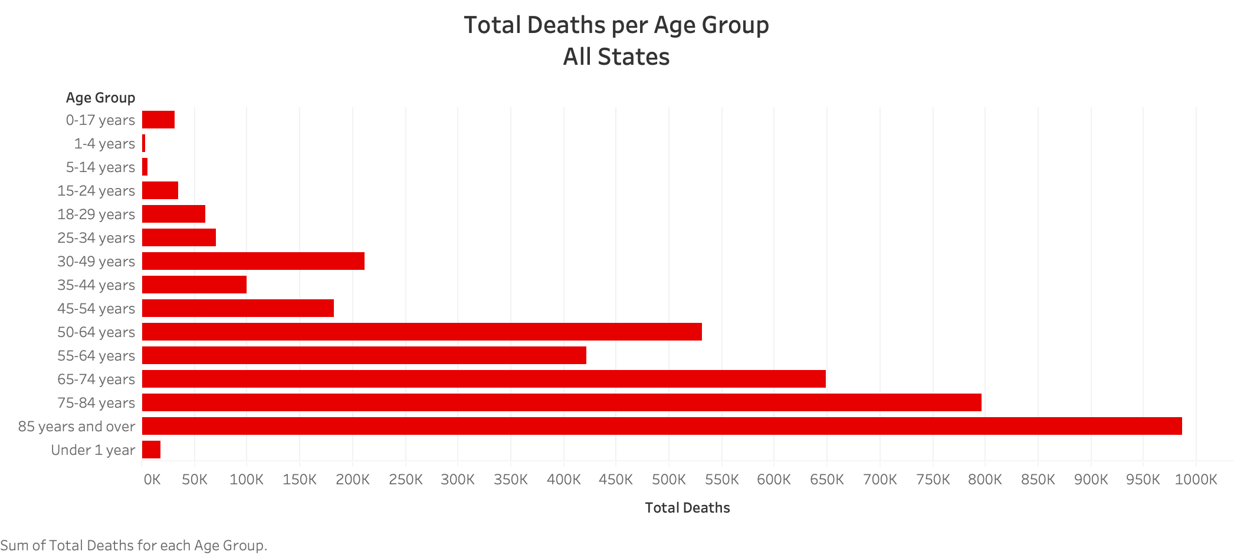

Slide 3
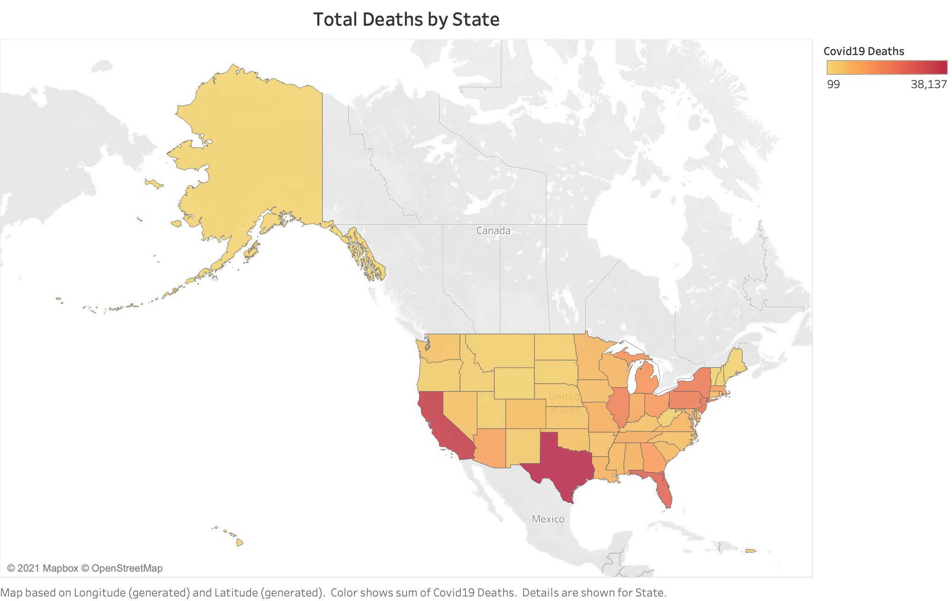

Slide 4
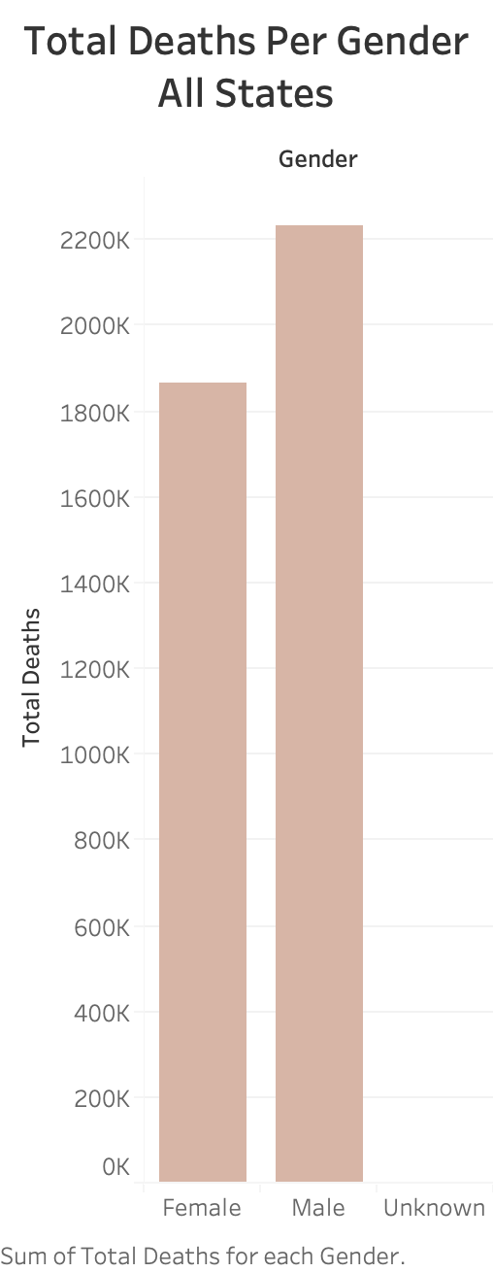

Slide 5
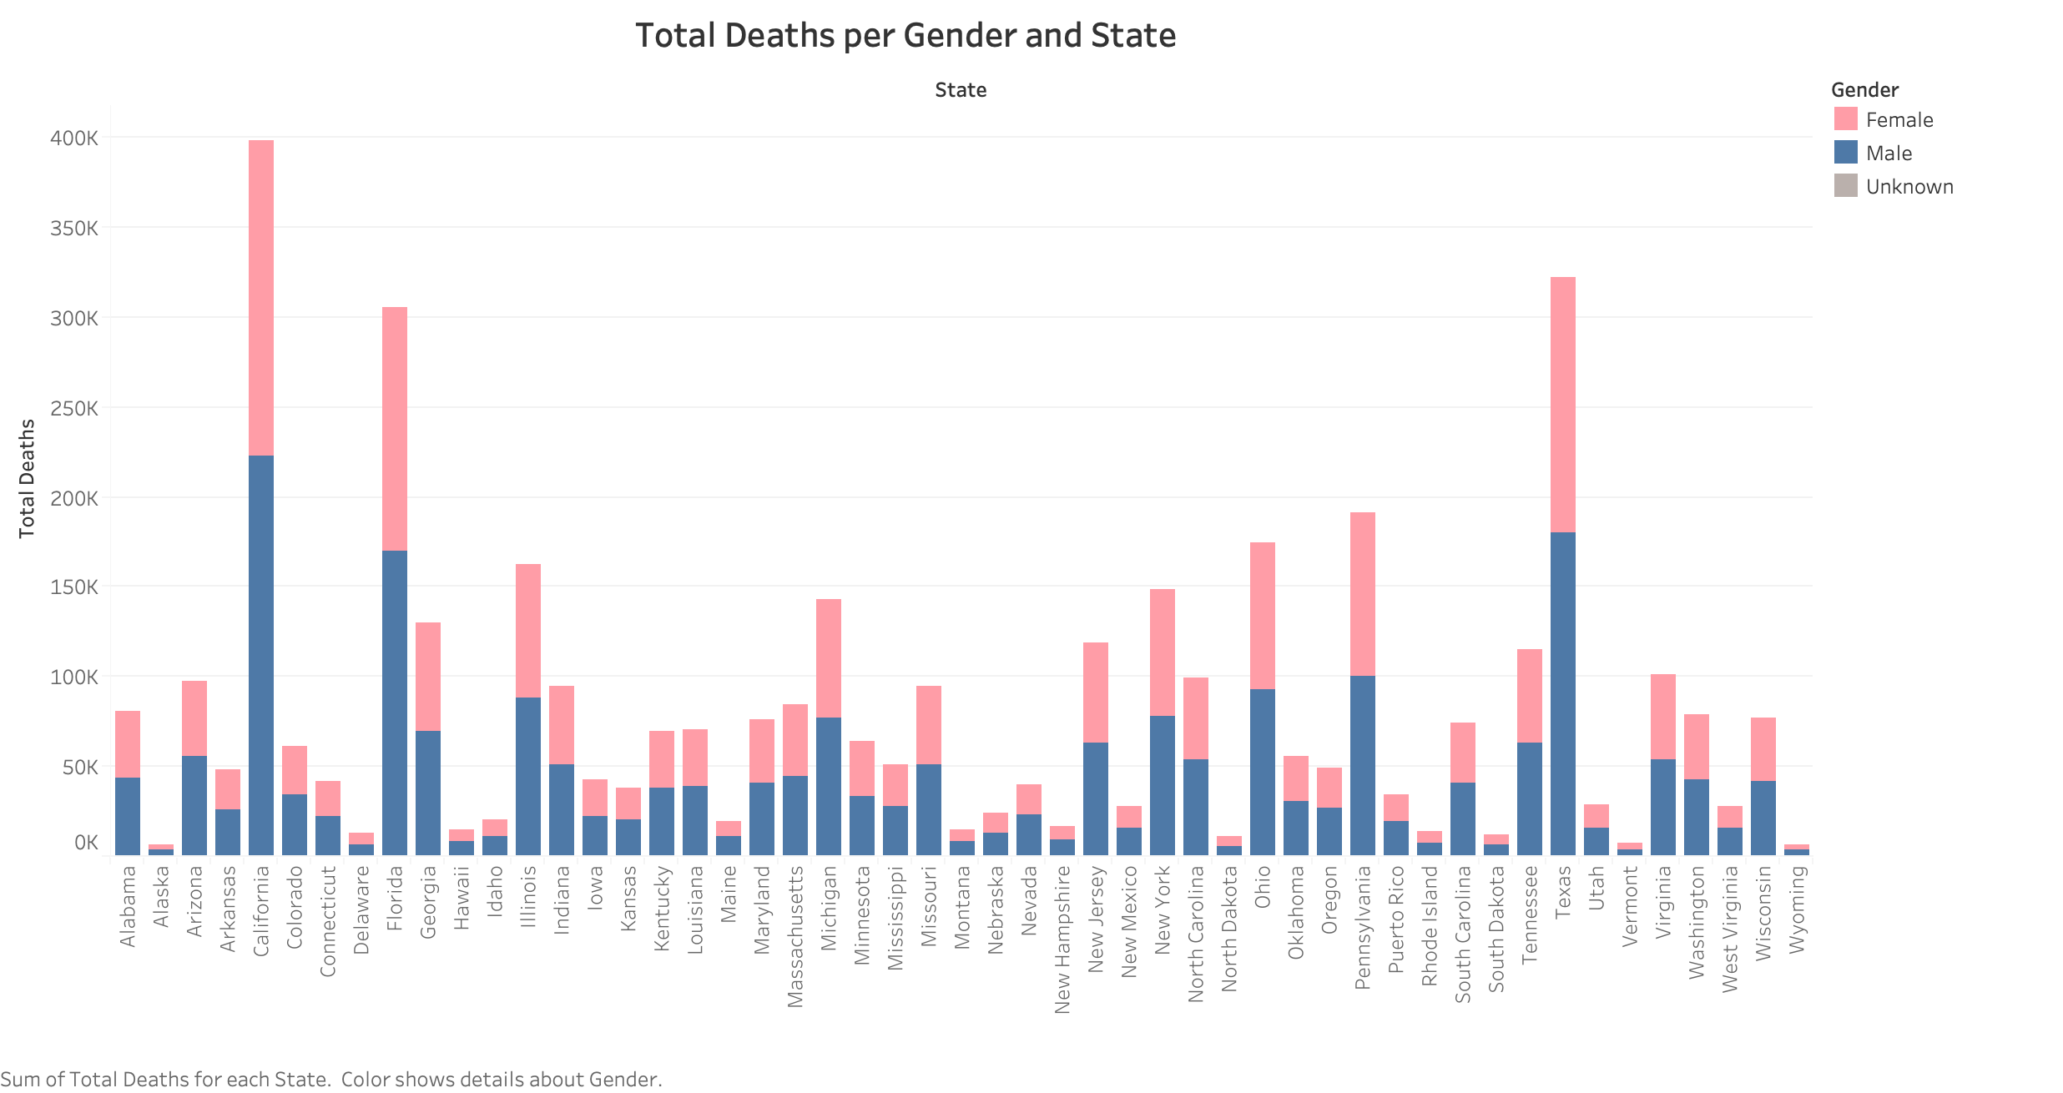

Slide 6
